Slide 1
18ECO133T-SENSORS AND TRANSDUCERS
UNIT II
Dr.M.Vidhyalakshmi

Slide 2
UNIT II
Introduction to Inductive sensor-Sensitivity and linearity of the sensor-Transformer type transducer-Electromagnetic transducer-Magnetosrictive transducer -Materials used in inductive sensor-Mutual Inductance change type-LVDT: Construction-Material, input output relationship-Synchros-Construction-Capacitive sensor: Introduction-Parallel plate capacitive sensor-Variable thickness dielectric capacitive sensor-Electrostatic transducer-Piezoelectric elements-Ultrasonic Sensors-Calculation of sensitivity-Capacitor microphone, response characteristics

Slide 3
Introduction to Inductive Sensor-Basic Concept
uses the principle of electromagnetic induction to detect or measure objects
An inductor develops a magnetic field when a current flows through it; alternatively, a current will flow through a circuit containing an inductor when the magnetic field through it changes. This effect can be used to detect metallic objects that interact with a magnetic field.
Non-metallic substances such as liquids or some kinds of dirt do not interact with the magnetic field, so an inductive sensor can operate in wet or dirty conditions.

Slide 4
One form of inductive sensor drives a coil with an oscillator.
A metallic object approaching the coil will alter the inductance of the coil, producing a change in frequency or a change in the current in the coil.
These changes can be detected, amplified, compared to a threshold and use to switch an external circuit.
The coil may have a ferromagnetic core to make the magnetic field more intense and to increase the sensitivity of the device.
A coil with no ferromagnetic core ("air core") can also be used, especially if the oscillator coil must cover a large area.
Another form of inductive sensor uses one coil to produce a changing magnetic field, and a second coil (or other device) to sense the changes in the magnetic field produced by an object, for example, due to eddy currents induced in a metal object

Slide 5
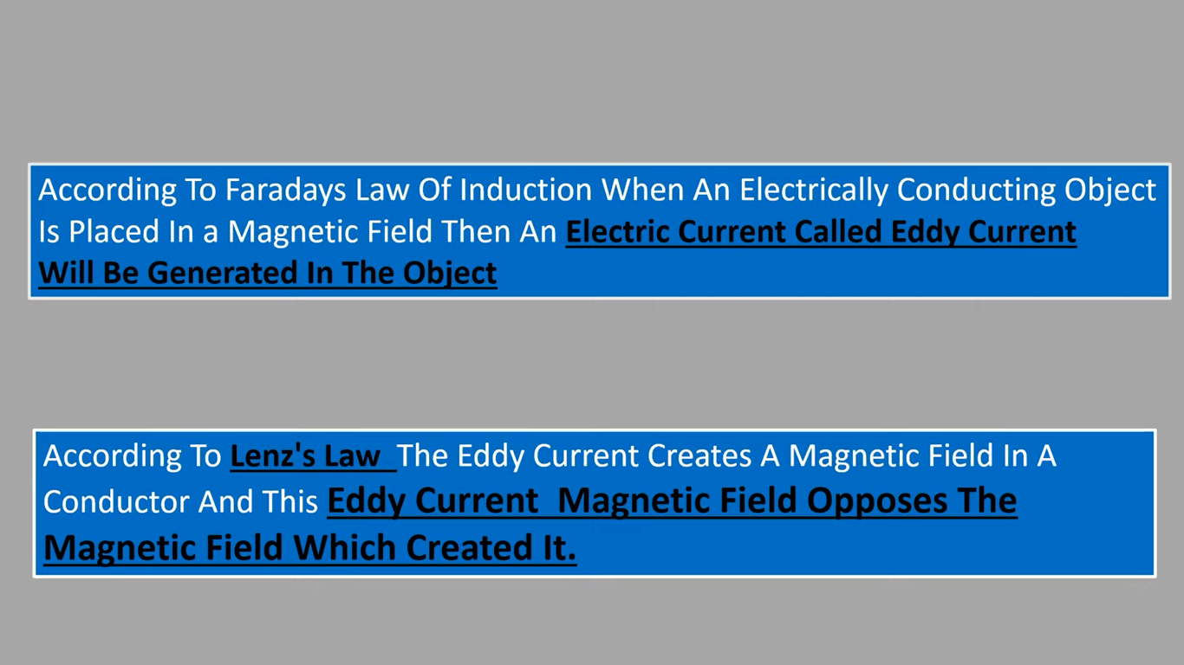

Slide 6
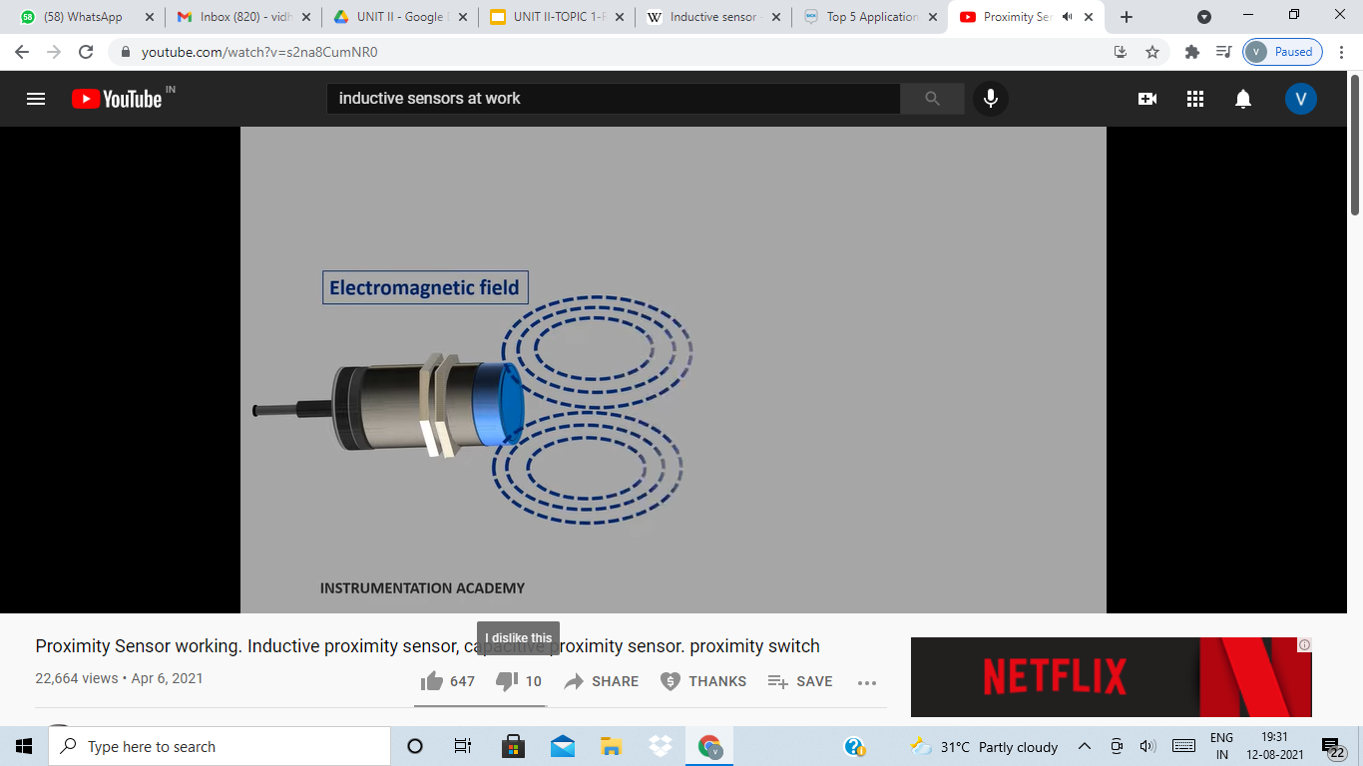
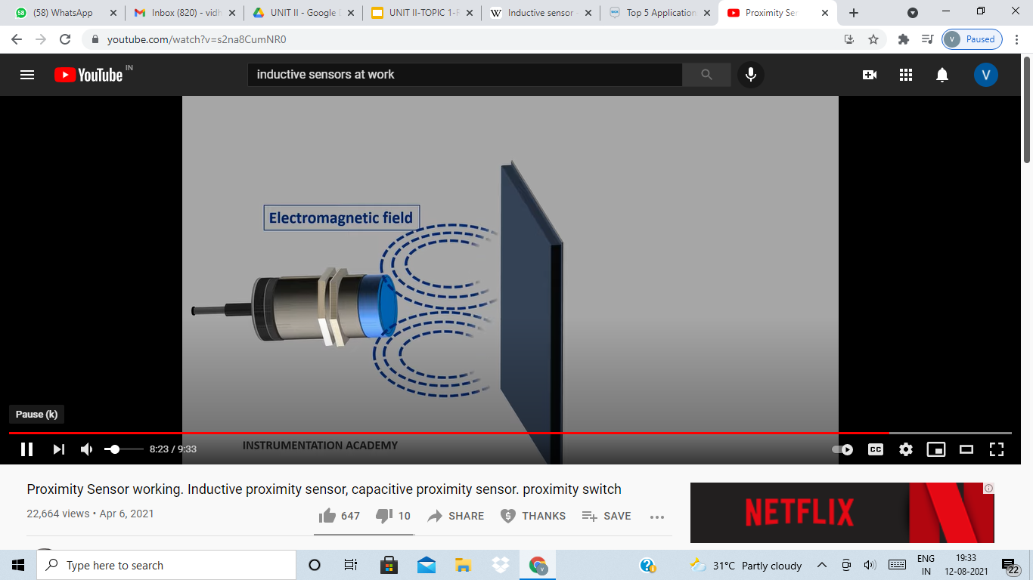
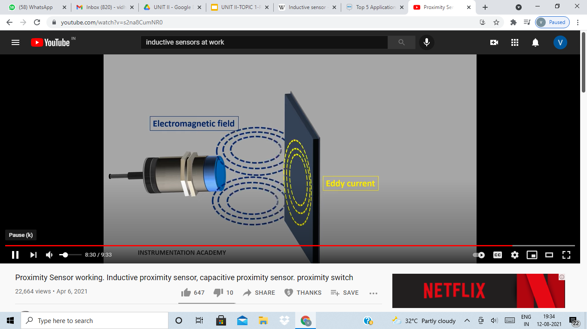

Slide 7
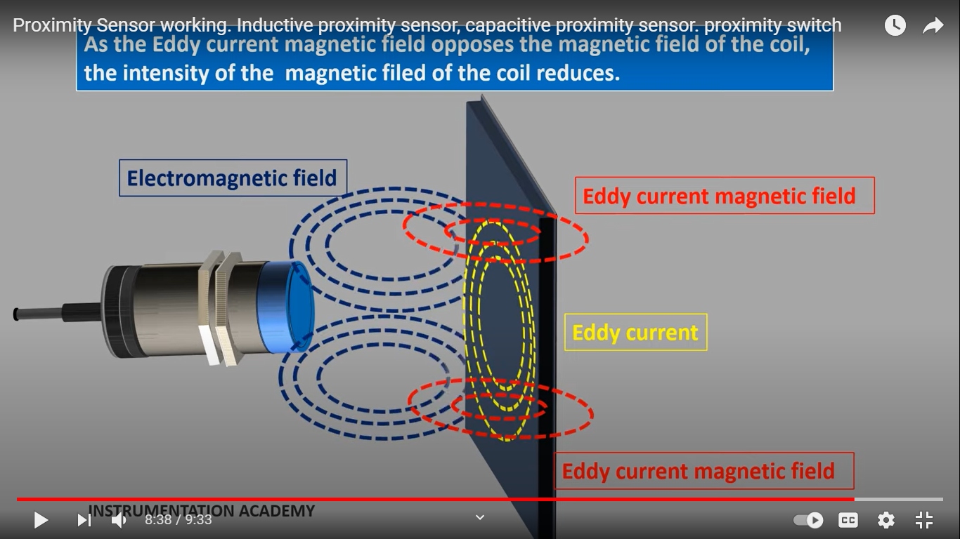

Slide 8
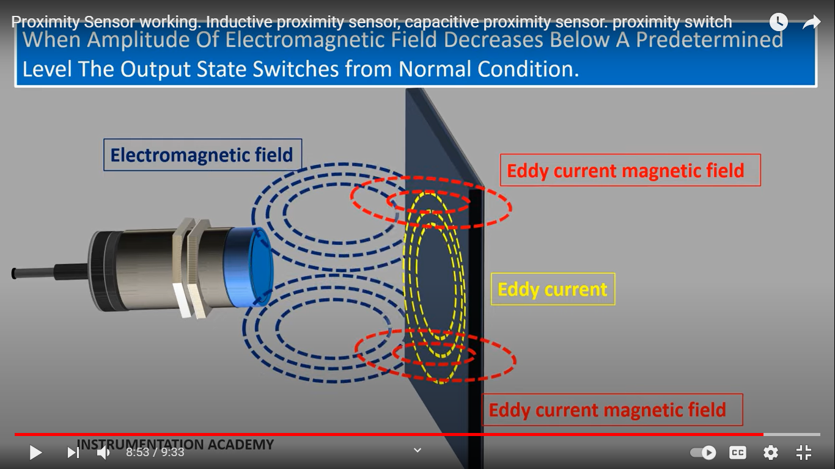

Slide 9
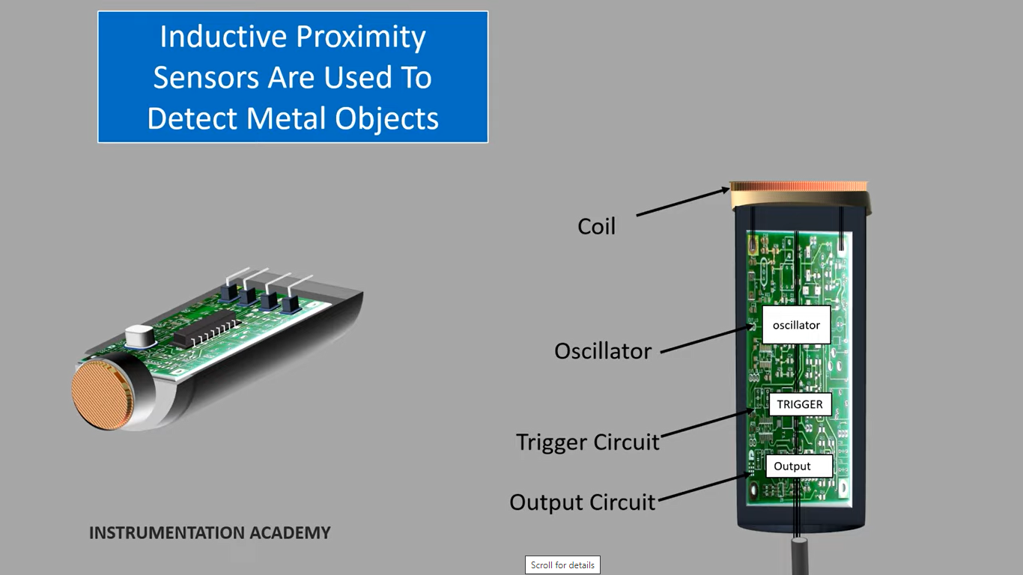
Application-Proximity sensor

Slide 10
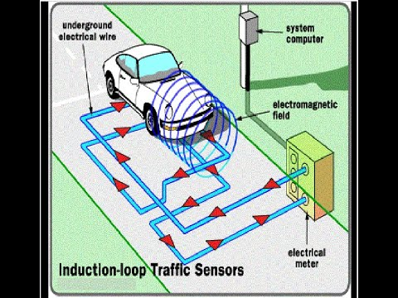

Application-Induction loop Traffic sensors

Slide 11

Application

Slide 12
Terms to know
Magnetic field -is a region where magnetic poles and moving charges experience a force
Magnetic flux -measurement of how much magnetic field passes through an area.Magnetic flux shows the quantity or strength of magnetic lines produced by the magnet.Magnetic flux is a scalar quantity
Magnetic field strength (H) is the magnetising force. This magnetising force is directly proportional to current carried by the conductor and length of conductor.
Magnetic flux density(B) is a vector quantity.It is the amount of magnetic force induced on the given body due to the magnetising force H. The amount of magnetic force induced depends upon the strength of H and the nature of medium of the given body.

Slide 13
Reluctance-the opposition offered in a magnetic circuit to magnetic flux
Mutual Inductance-When two coils are brought in proximity with each other the magnetic field in one of the coils tend to link with the other. This further leads to the generation of voltage in the second coil. This property of a coil which affects or changes the current and voltage in a secondary coil is called Mutual Inductance
Eddy currents - are loops of electrical current induced within conductors by a changing magnetic field in the conductor according to Faraday's law of induction

Slide 14
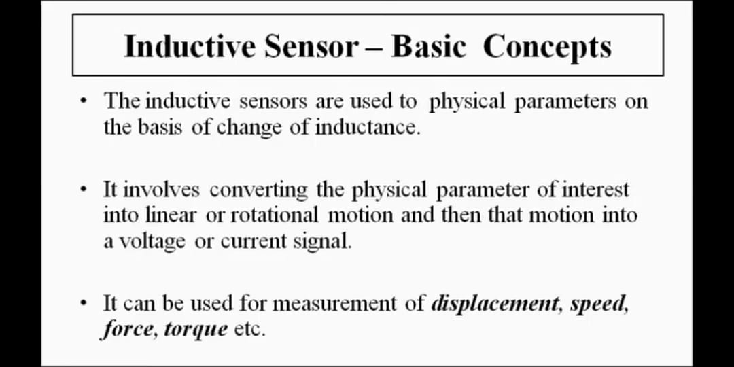
Inductive Sensor

Slide 15
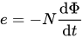
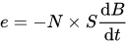
The inductive sensor is based on Faraday's law of induction.
The temporal variations of the Magnetic Flux through a N turns circuit will induce a voltage e which follows:
which can be expressed in a simpler way:
by assuming that the induced magnetic field B is homogeneous over a section S (the Magnetic flux will be expressed =B X S

Slide 16
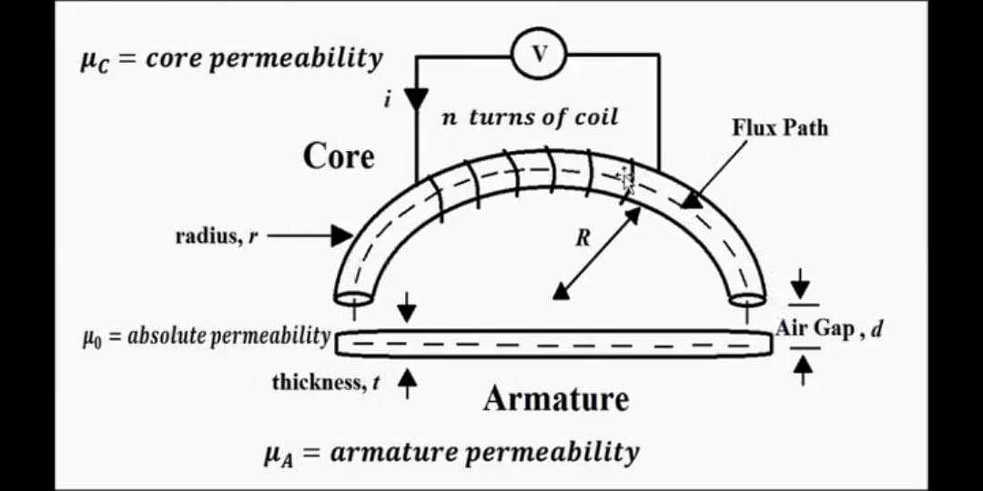
Parts of an Inductive Sensor
Ferromagnetic Core
Ferromagnetic Armature
Air Gap

Slide 17
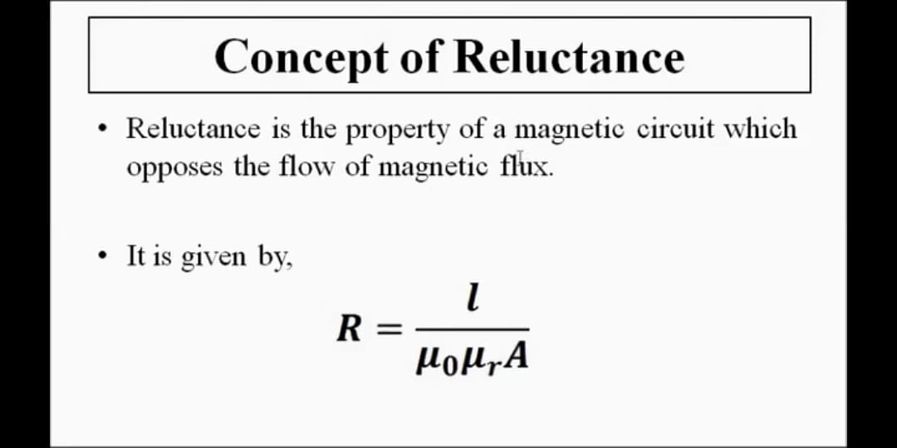
Reluctance

Slide 18
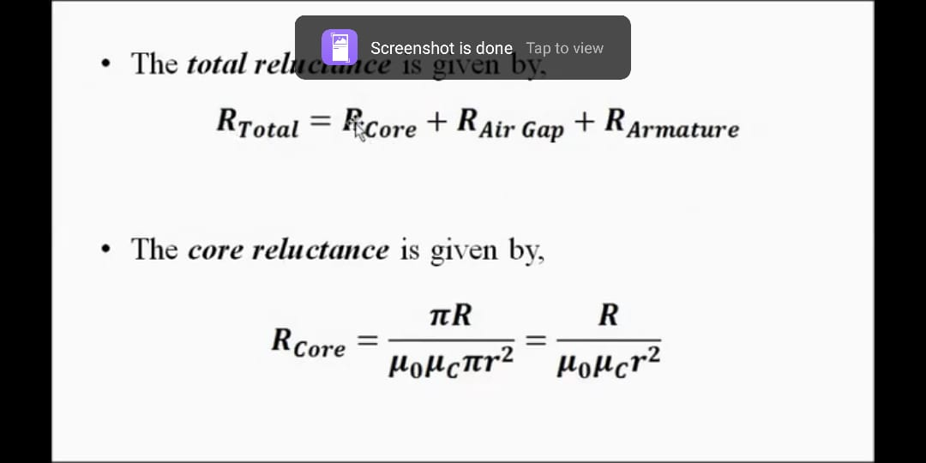
The Total Reluctance is given by

Slide 19
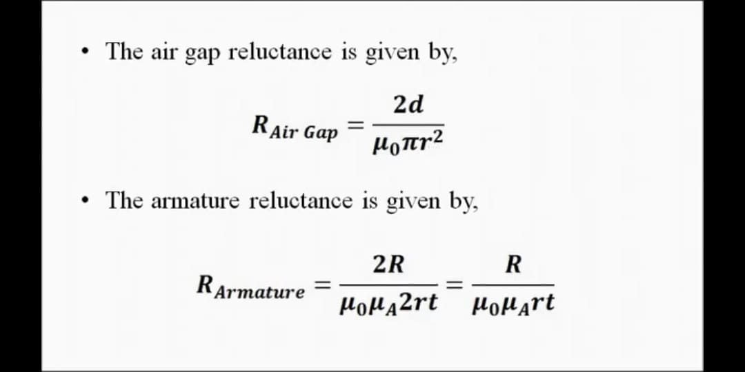

Slide 20
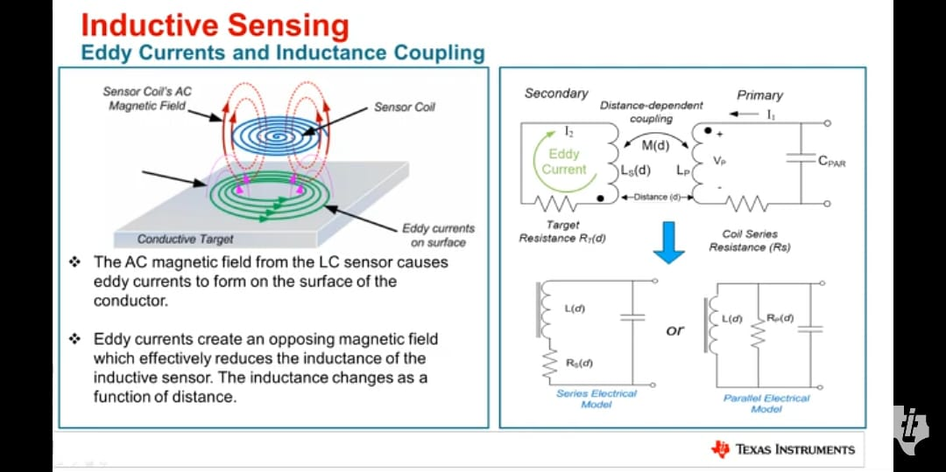

Slide 21
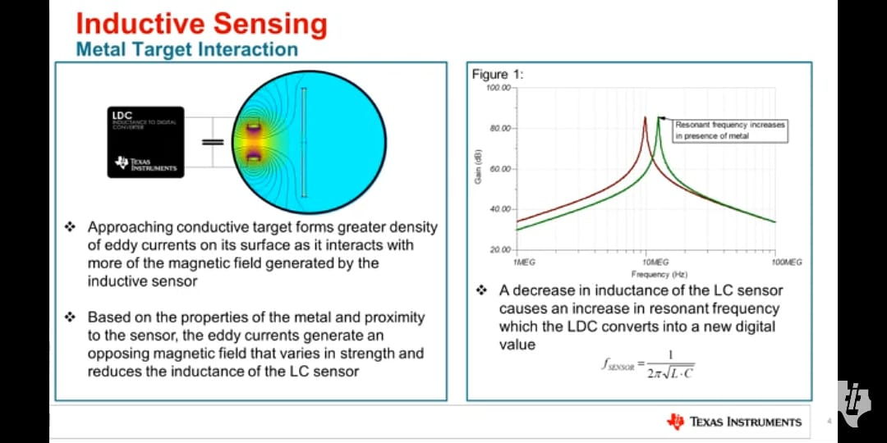

Slide 22
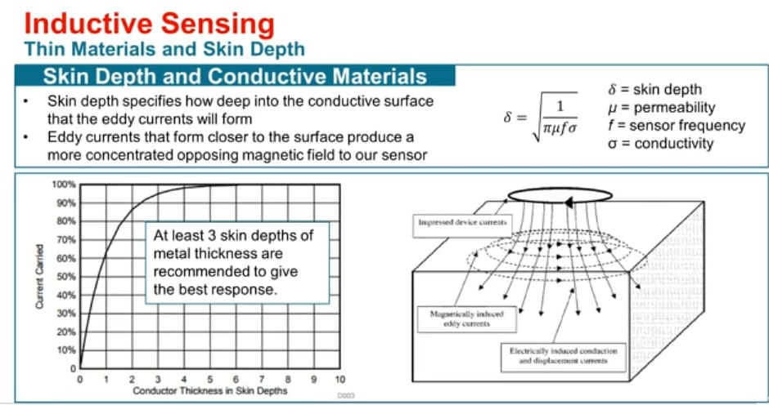

Slide 23
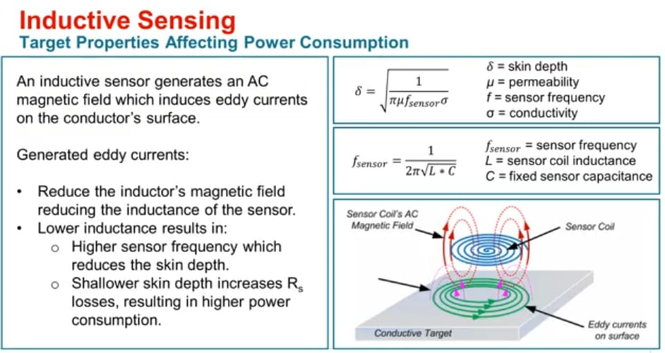

Slide 24
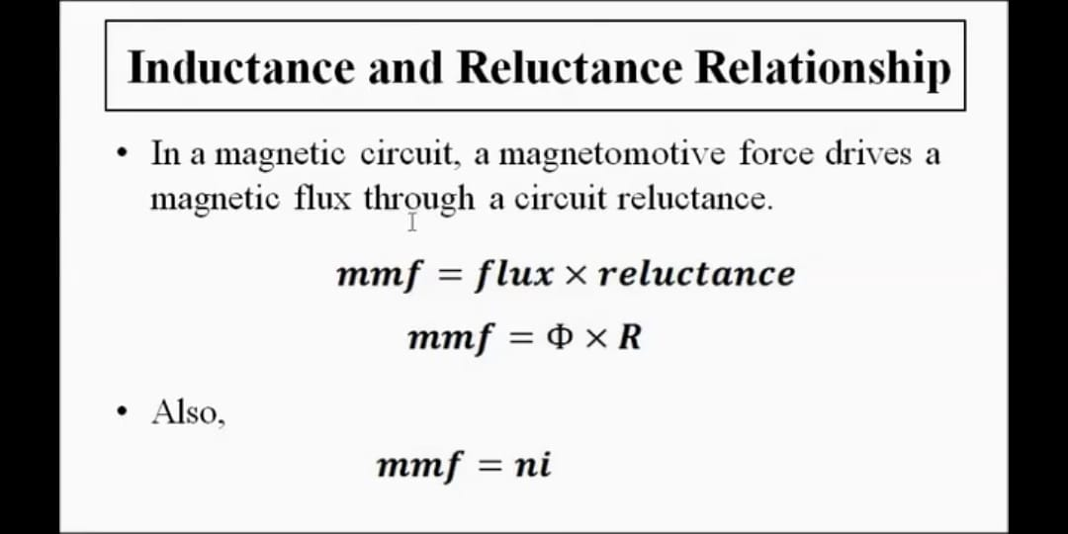

Slide 25
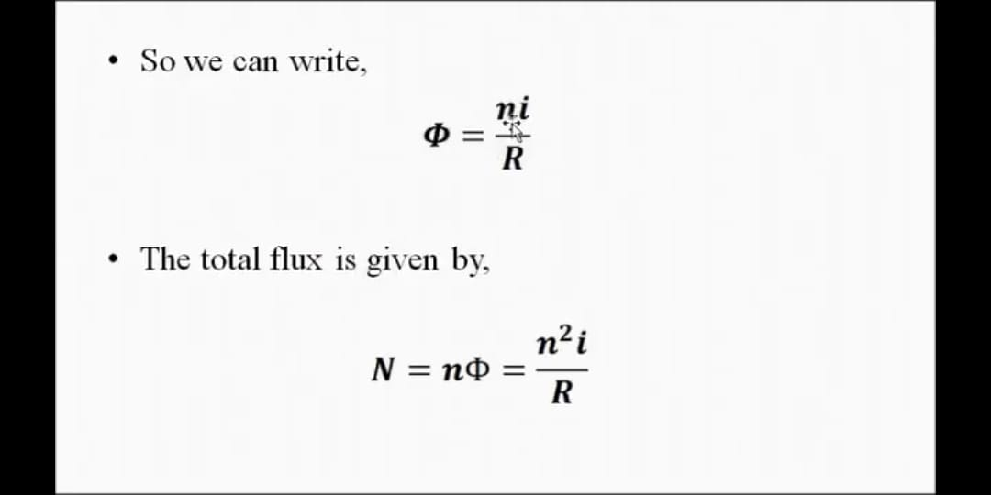

Slide 26
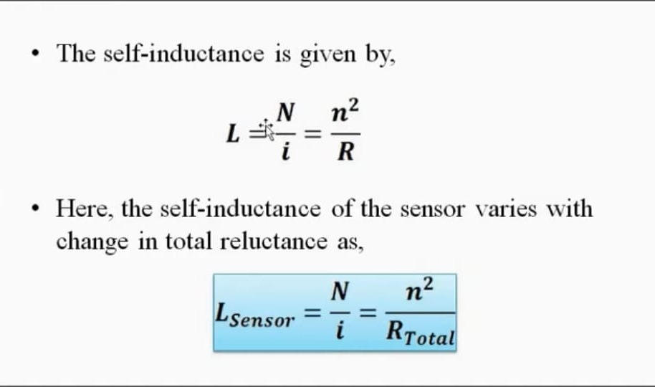

Slide 27
The two most common methods of achieving variation in inductance are
(i) by changing the reluctance of the magnetic path and
(ii) by coupling two or more elements.
The latter technique works by
(a) change of mutual inductance,
(b) change of eddy current when one element is just a short-circuited sleeve, and
(c) transformer action

Slide 28
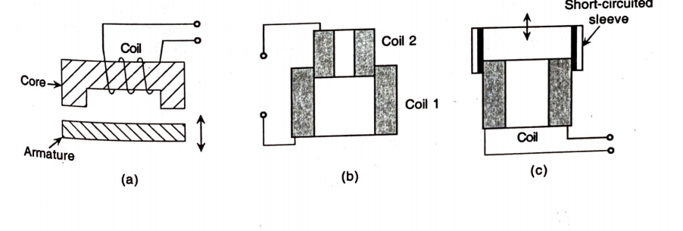
(a) change of reluctance of magnetic path, (b) change of mutual inductance between two coils, (c) change of mutual inductance between a coil and a sleeve,

Slide 29
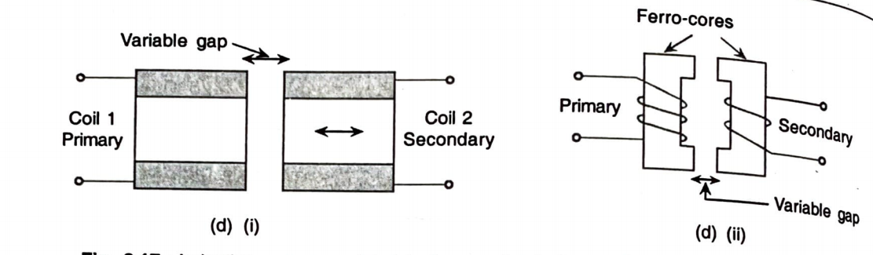
(d) (i) and (ii) transformer action.

Slide 30
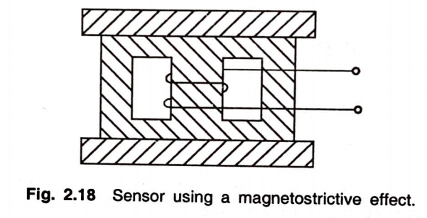
Types
Inductive sensors of
(i) the electromagnetic type which are bilateral in operation with electrical and mechanical input/output relationship and (ii) the magnetostrictive Type

Slide 31
A coil is an essential part of inductive transducers
The coil may be wound on a metal (iron) core or an air core.
In the variable reluctance type,
the core is a ferromagnetic material as also the armature.
This type of sensors are, perhaps, the most extensively used because it (i) is the most sensitive one, (ii) is least affected by external fields as the air gap is least, and (iii) requires less number of turns than in air core design for same value of inductance so that interwinding or self-capacitance and stray effects are less.

Slide 32
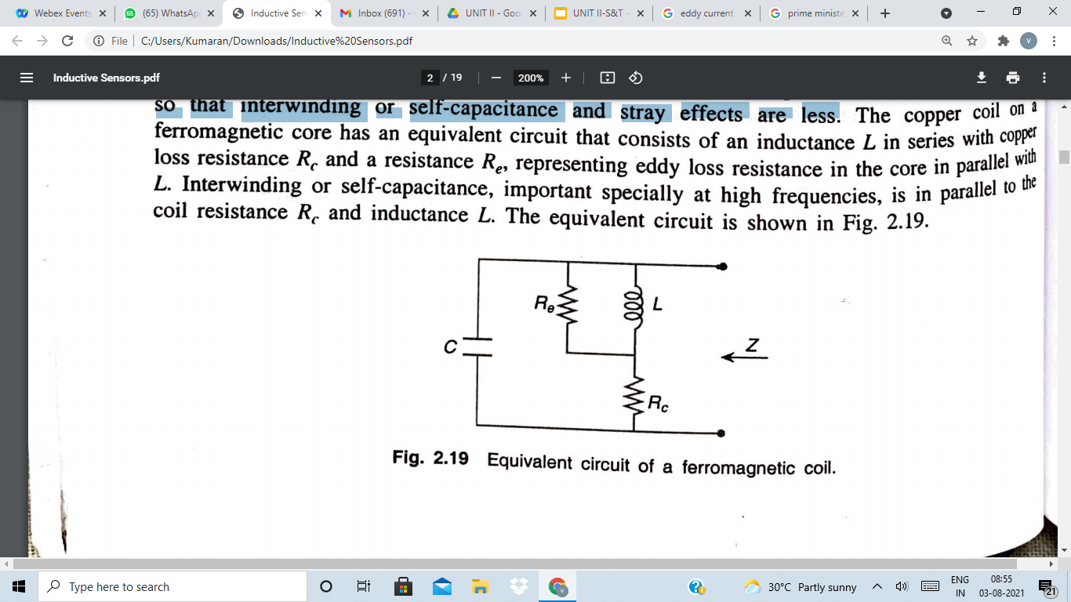
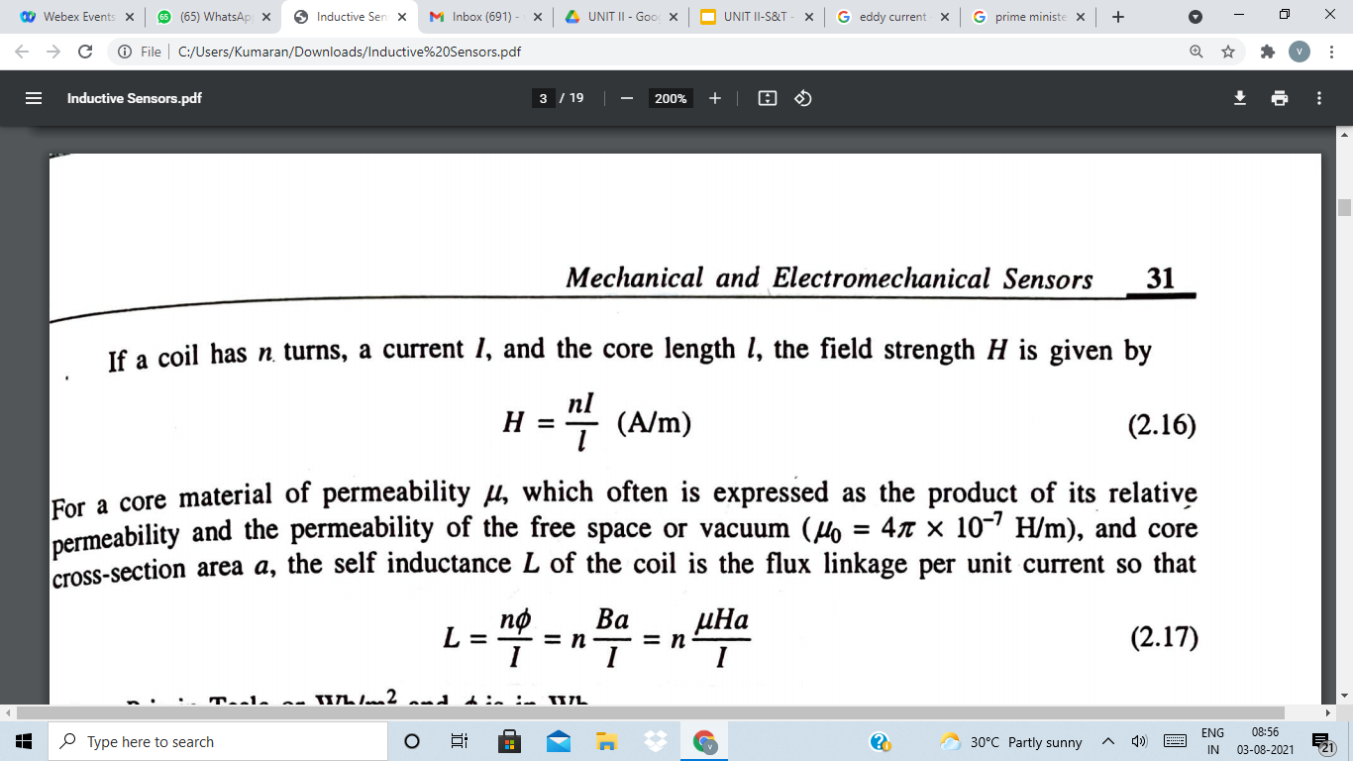
n-Number of turns
I=Current
l=corelength
H=Field strength
L=Self Inductance
(2.16)

Slide 33
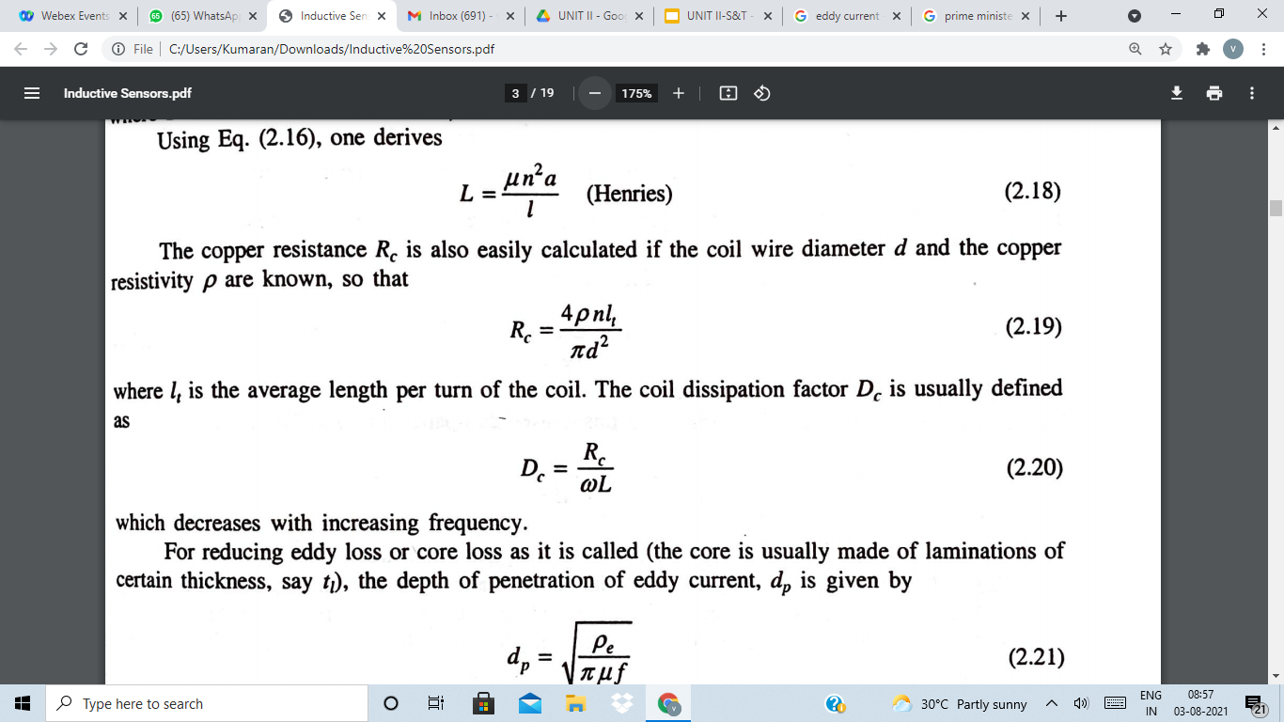
From eq.2.16
Copper Resistance is given by
Coil Dissipation Factor is given by
The Depth of Penetration of Eddy current is given by

Slide 34
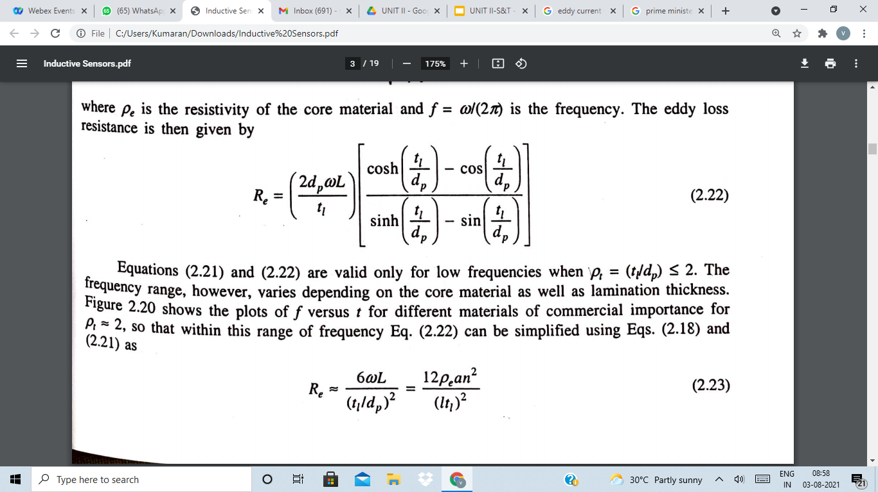
Eddy loss resistance is given by
T
This Equation is simplified using eq(2.18) and eq.(2.21) as

Slide 35
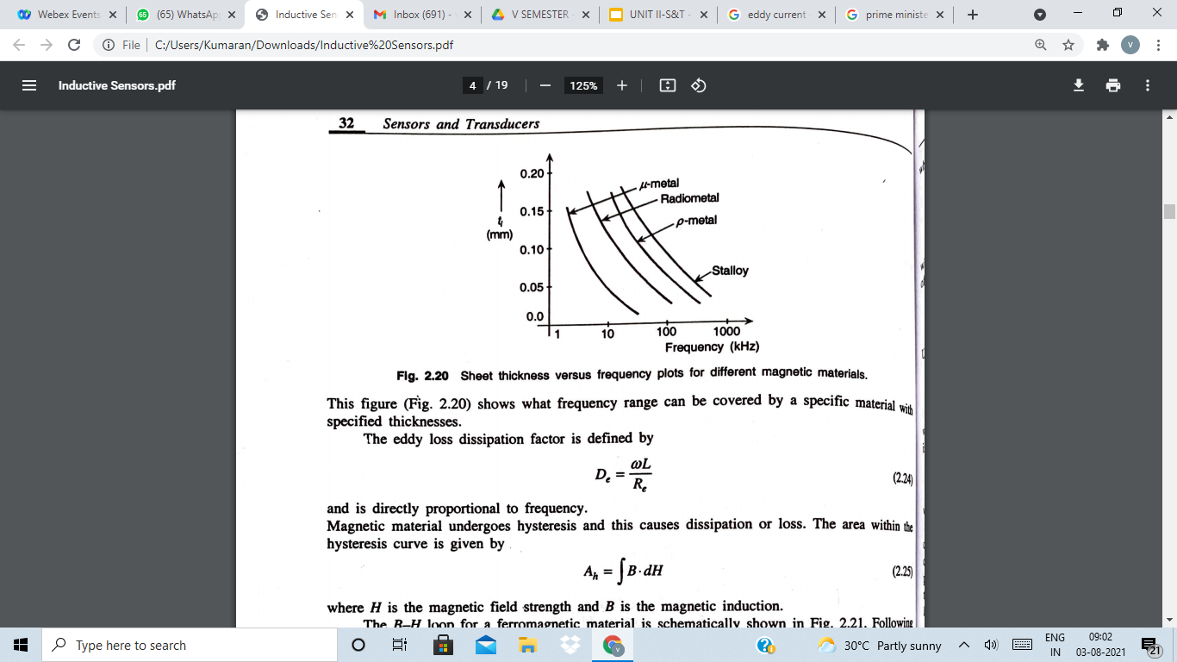
Eddy loss Dissipation factor is given by
The Area within the Hysteresis Curve is given by

Slide 36
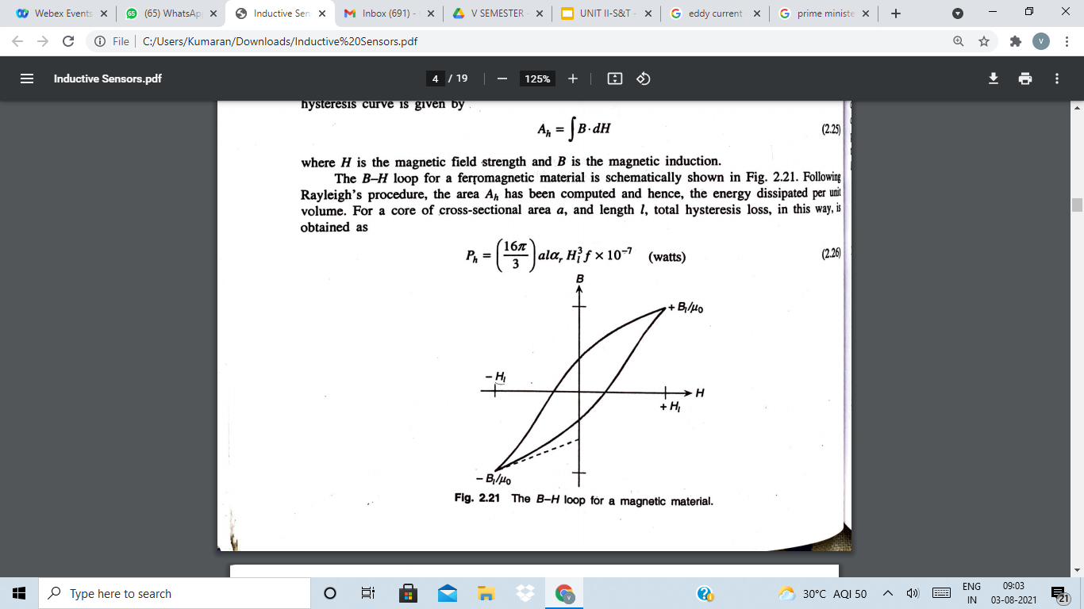
The Total Hysteresis law is given by

Slide 37
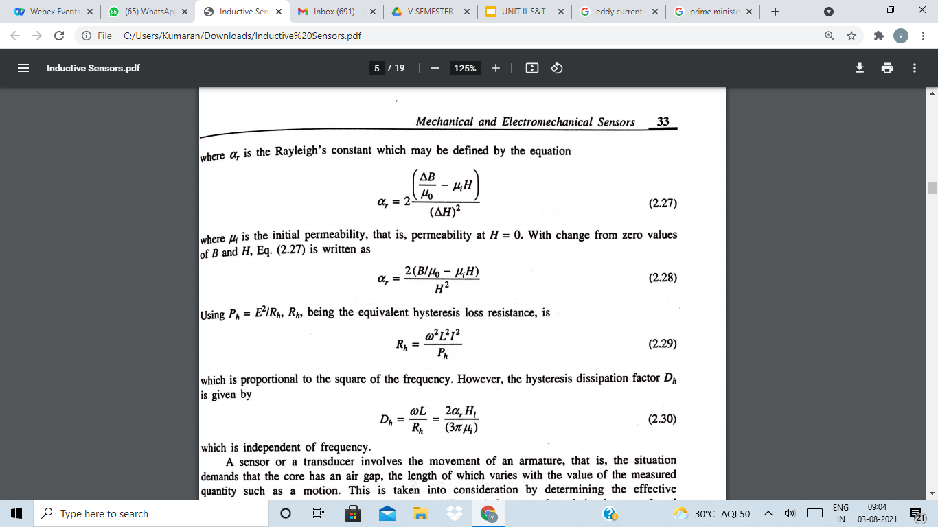
The Rayleigh’s constant is given by

Slide 38
The Hysteresis Dissipation factor is given by

Slide 39
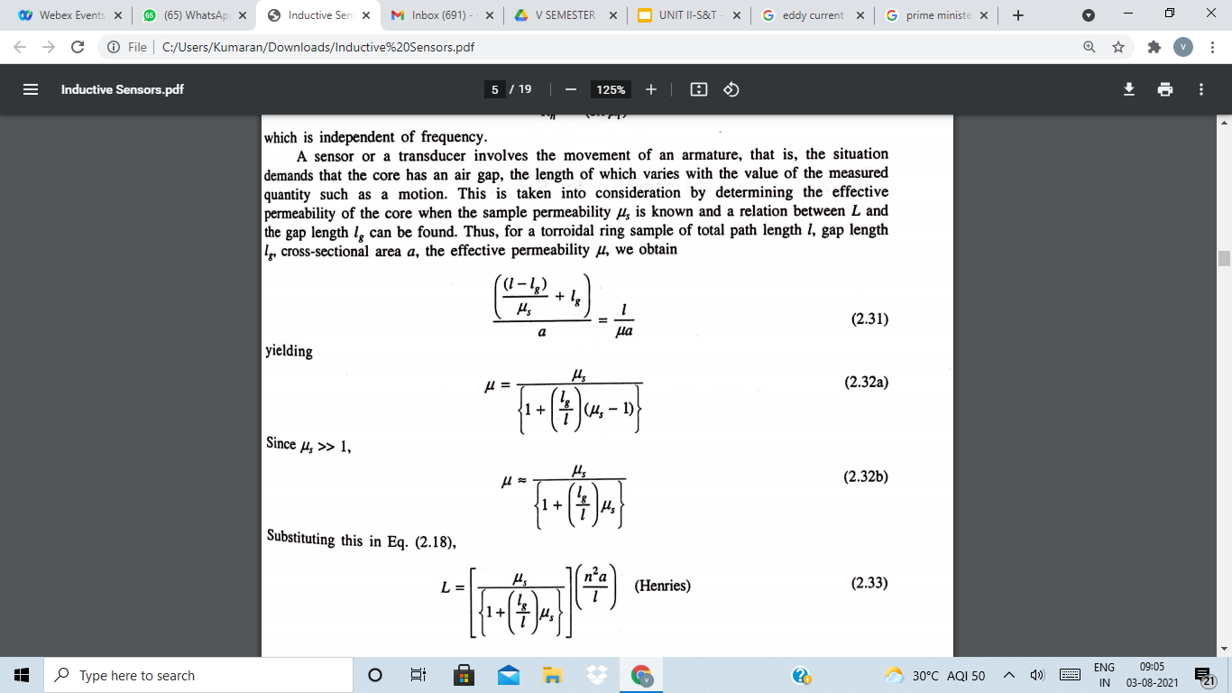
The Effective Permeability is given by
Where,l is the total path length and lg is the Gap length

Slide 40
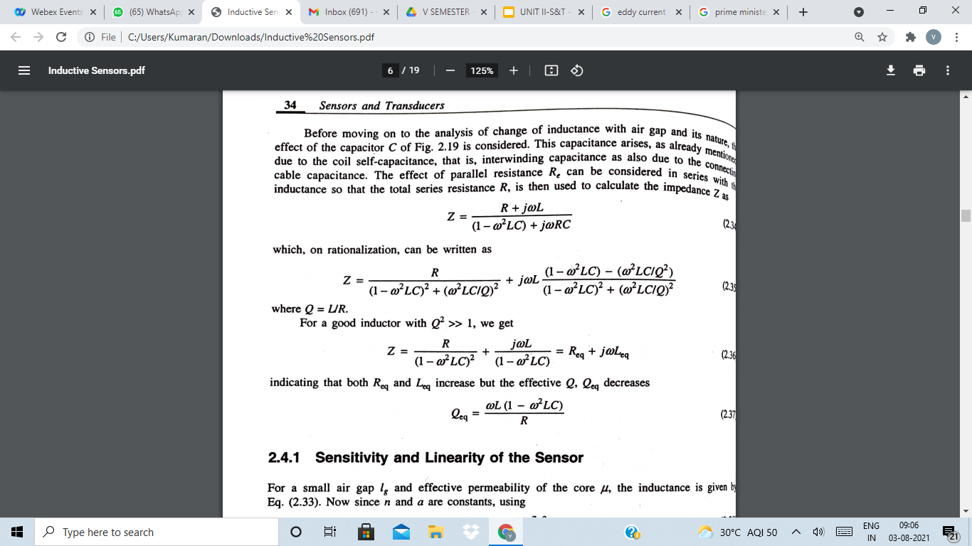
The Impedence is calculated by

Slide 41
APPLICATIONS
Search coil magnetometer
Inductive proximity sensor
Metal detectors
Traffic lights
Car washes
Many automated industrial processes.
The sensor does not require physical contact it is particularly useful for applications where access presents challenges or where dirt is prevalent

Slide 42
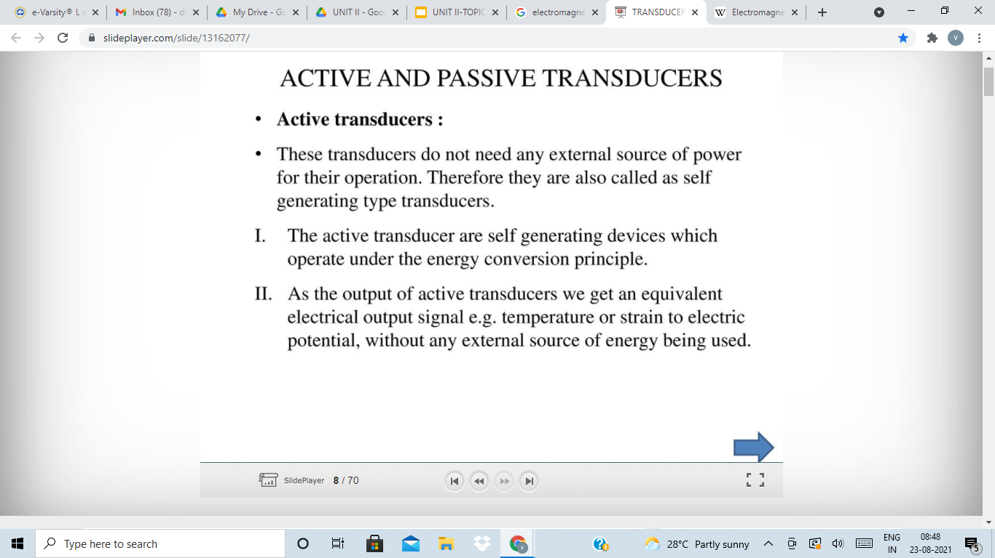

Slide 43
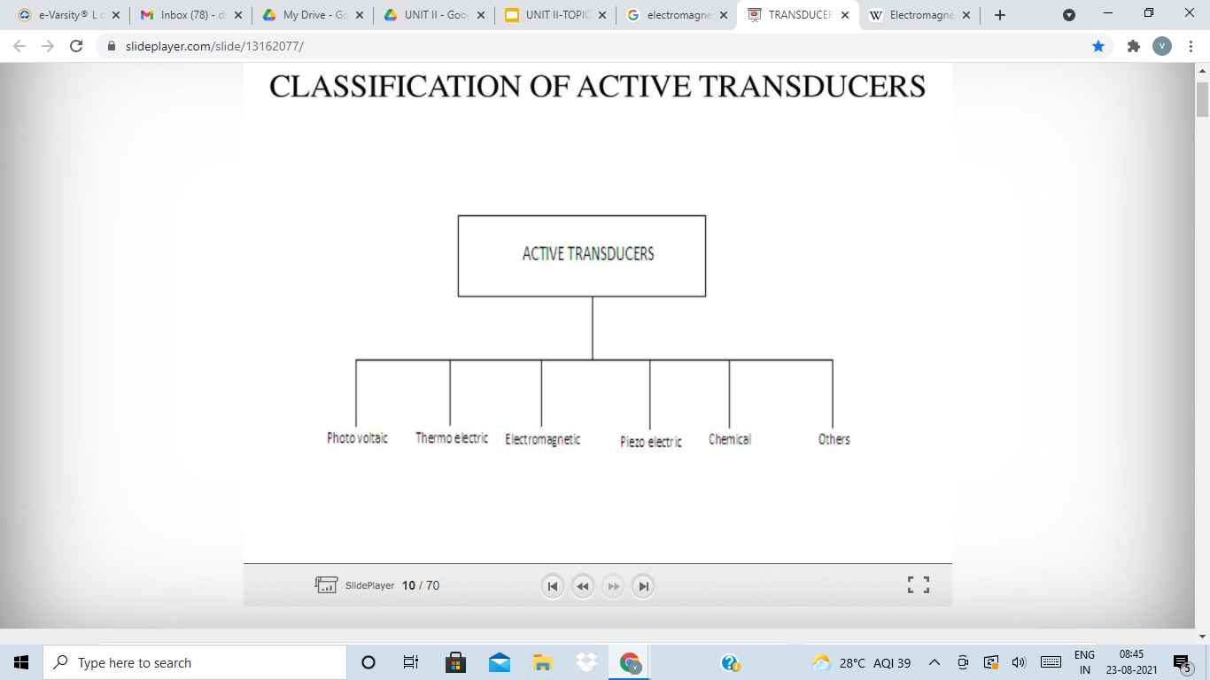

Slide 44
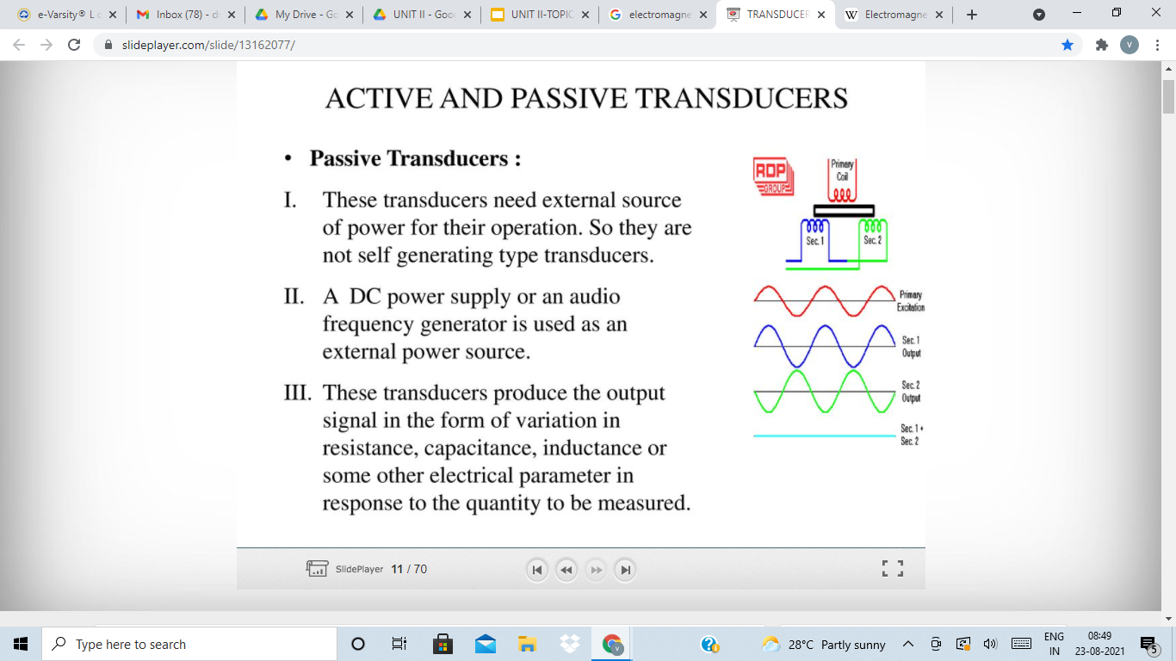

Slide 45
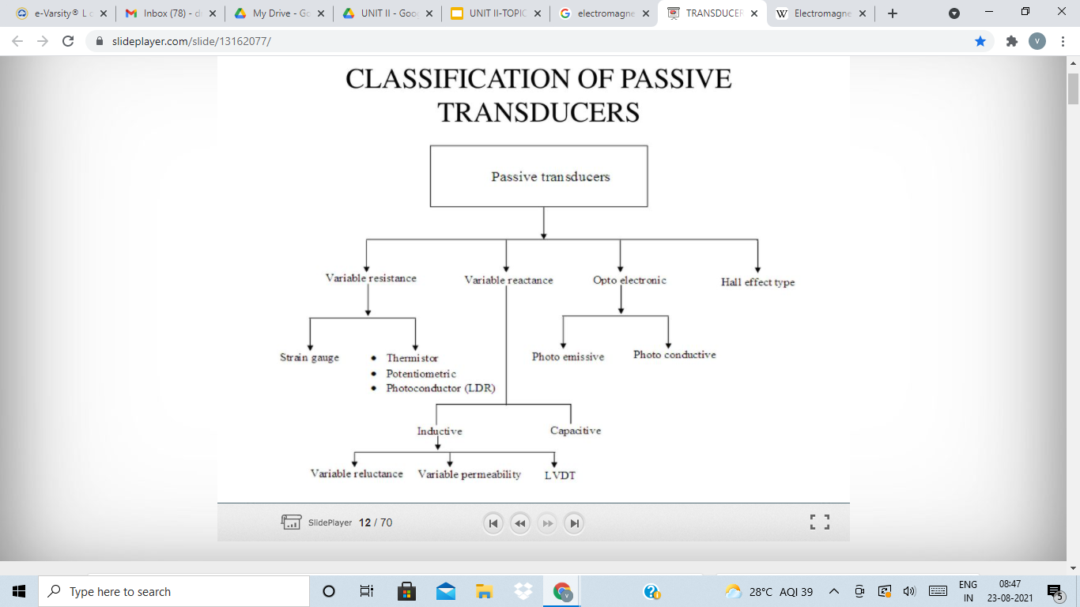

Slide 46
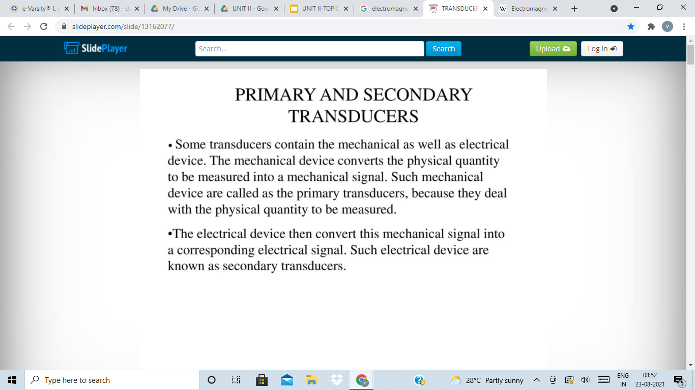

Slide 47
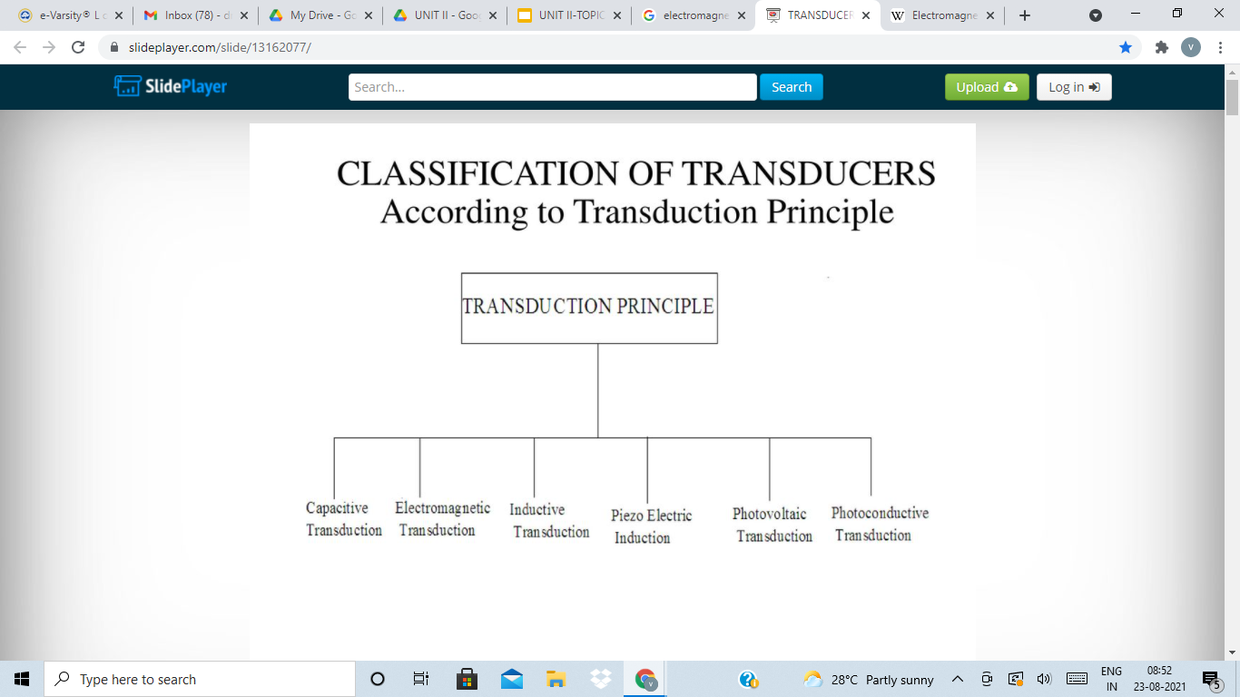

Slide 48
TRANSFORMER TYPE TRANSDUCER
To measure mechanical quantities, such as displacement, force, and angle of rotation, according to the change in the transformation ratio of a transformer or in the mutual induction between the transformer’s primary and secondary windings

Slide 49
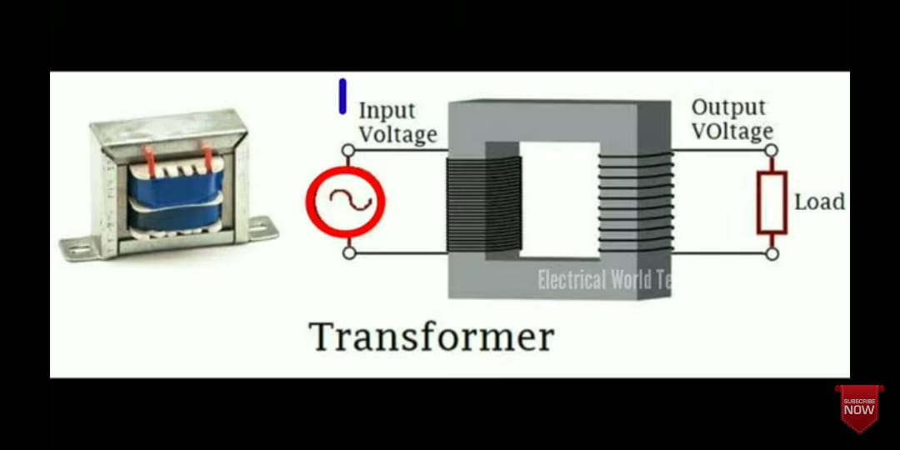

Slide 50
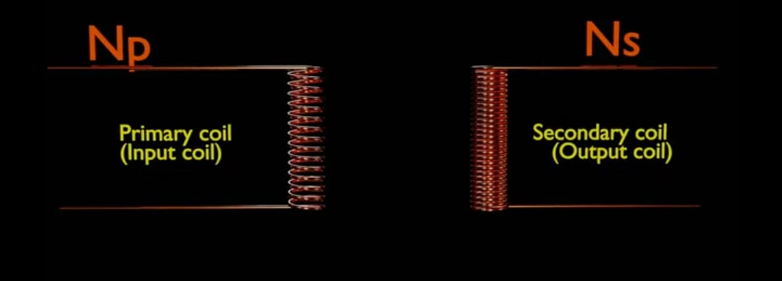

Slide 51
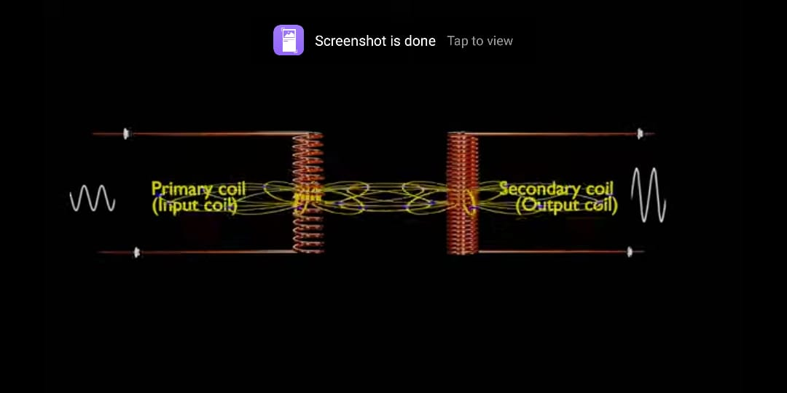

Slide 52
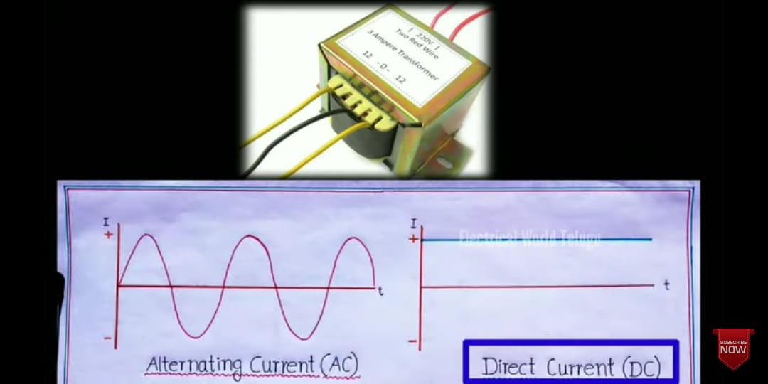

Slide 53
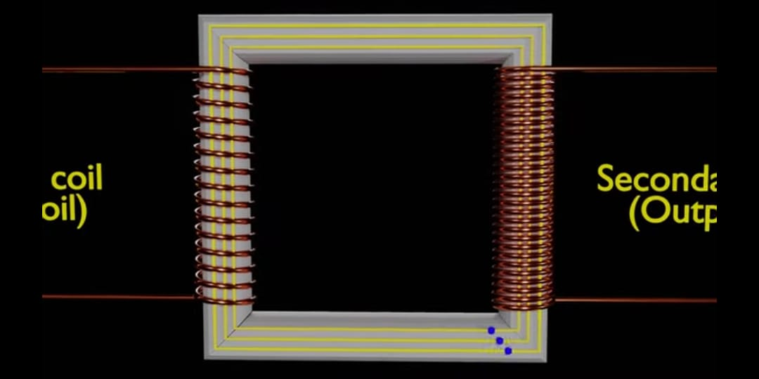

Slide 54


Slide 55
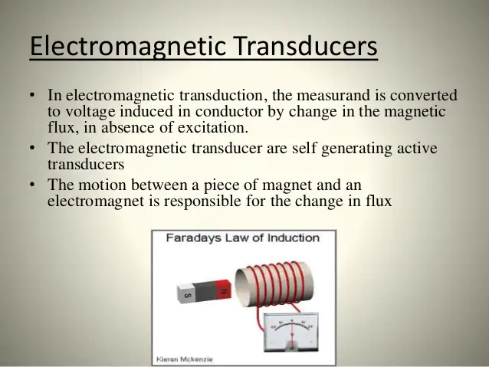
Electromagnetic Transducer

Slide 56
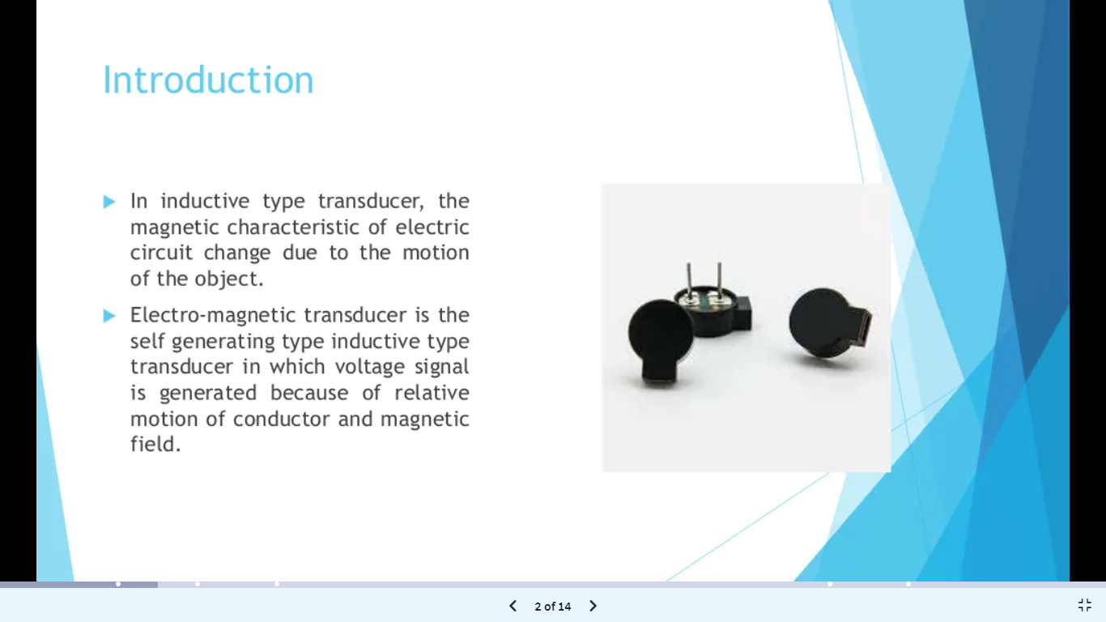

Slide 57
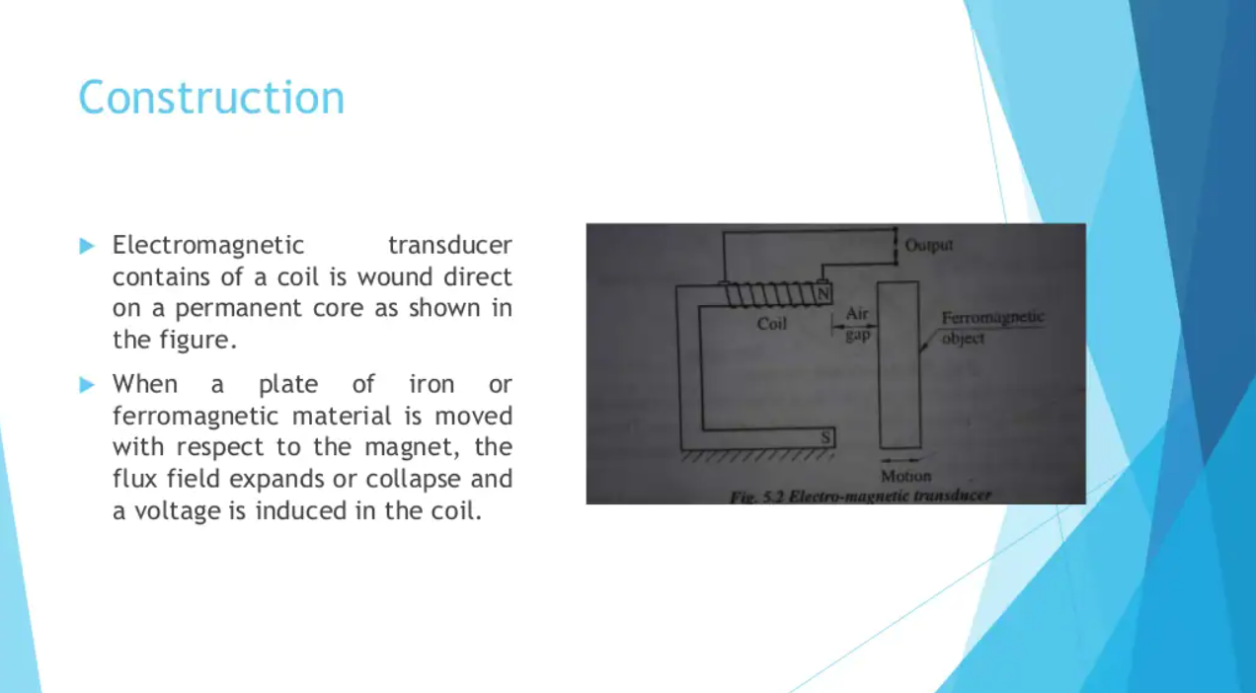

Slide 58
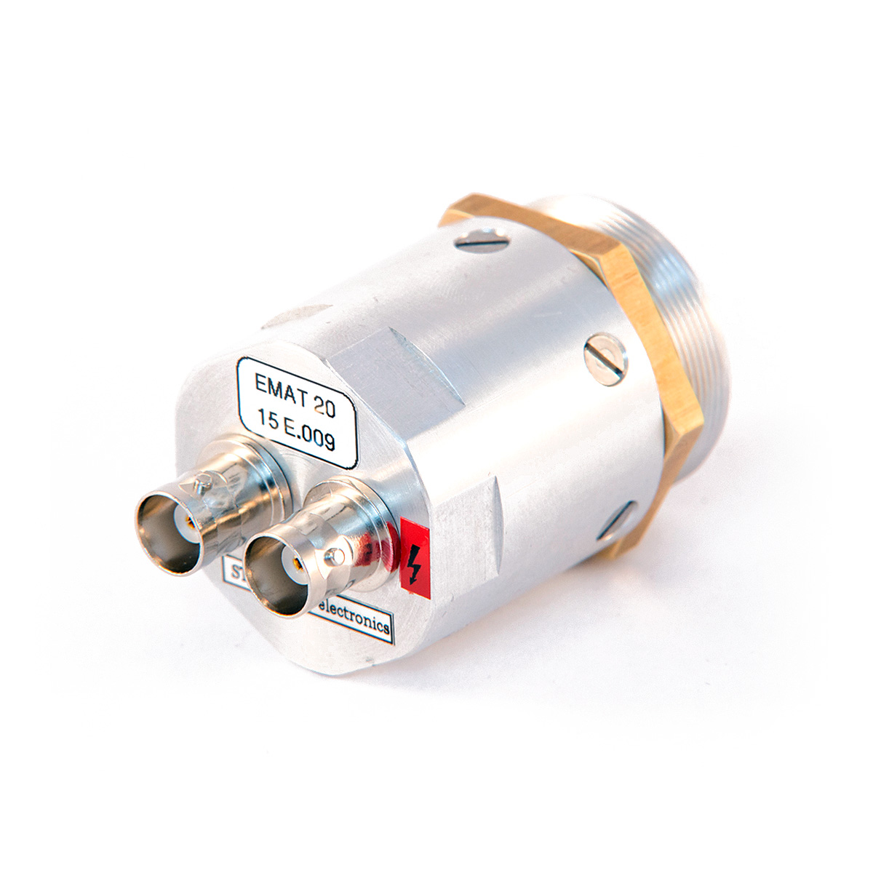
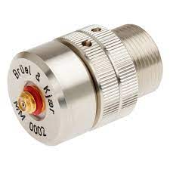
ELECTROMAGNETIC TRANSDUCER

Slide 59
Magnetostrictive Transducer
Magnetostrictive position sensors are non-contact linear position sensors
They use the momentary interaction of two magnetic fields to produce a strain pulse that moves along a waveguide. One field is from a magnet that moves along the outside of the waveguide. The other field is from the waveguide itself.
Magnetostrictive position sensors a unique signal for each point along the axis of travel.
The advantage to this type of sensor is that it is non-contact and there is no wear or friction. It is also not affected by vibrations so there is no limit on the number of operating cycles.
The disadvantage is the dead band on both sides of the sensor which cannot be reduced to zero.

Slide 60

Magnetrostriction is a property of ferromagnetic materials to expand or contract when placed in a magnetic field. T
The sensor senses the position of the permanent (position) magnet to determine the distance between the permanent magnet and the sensor head.
There are five main components of the magnetostrictive sensor: Waveguide, position magnet, electronics, strain pulse detection system, and damping module.

Slide 61

Typically, the waveguide wire is enclosed within a protective cover and attached to the device that is being measured.
Applying a current pulse generates a sonic wave that travels along the waveguide to a small piece of magnetostrictive material that passes through a coil and is magnetized by a small, permanent magnet.
The stress induced by the sonic wave causes a wave of changed permeability in the magnetostrictive material, resulting in a change in its magnetic flux and the production of voltage output from the coil.
Electronic circuitry detects the voltage pulse and conditions it into the desired output.
At the sensor rod tip, at the end opposite the head, there is an unusable area called the dead zone. The system must be designed so that the front face of the position magnet will come no closer to the tip than the specified dead zone distance.

Slide 62

Applications
In workshops or in the automobile production cars are lifted for work on the substructure. This is usually done by hydraulic lifts. Hydraulic cylinders installed in the lifts hoist the cars. The stroke movement are measured by magnetostrictive transducers. The position measurement is especially important in automatized processes.

Slide 63

Lift bridges are built over busy waterways. These lift up when a ship wants to drive through the waterway. For this a bridge part is raised by means of hydraulic cylinders so far that the ship can easily pass underneath the lifted bridge.
Magnetostrictive transducers are installed inside the hydraulic cylinders. The sensors measure the stroke and transmit the values to a control unit. The hydraulic sensors ensure that the bridge part reaches the minimum height to let the ship pass.

Slide 64


Applications
Magnetostrictive transducers are used for position measurement.
The sensors are used to measure the stroke of hydraulic cylinders.
Industrial application
Installation in hydraulic cylinders.
Packing machines, plastic machines, steel rolls or in beverage bottling plants.

Slide 65


Slide 66
Materials used in Inductive Sensors
The core and armature material is ferromagnetic
Soft magnetic Ni-Fe alloy(high permeability, which is used for shielding sensitive electronic equipment against static or low-frequency magnetic fields.)
Manganese-zinc, Magnesium-zinc, Nickel-zinc
Notes:
Curie point, is the temperature above which certain materials lose their permanent magnetic properties, which can be replaced by induced magnetism
permeability is the measure of magnetization that a material obtains in response to an applied magnetic field

Slide 67


Slide 68


Slide 69


Slide 70


Slide 71


Slide 72


Slide 73


Slide 74


Slide 75


Slide 76


Slide 77


Slide 78


Slide 79


Slide 80


Slide 81


Slide 82


Slide 83


Slide 84


Slide 85


Slide 86


Slide 87


Slide 88


Slide 89


Slide 90


Slide 91


Slide 92


Slide 93


Slide 94


Slide 95

SYNCHROS
synchro is a generic name for a family of inductive devices which works on the principle of a rotating transformer (Induction motor)
They are electro mechanical devices or electromagnetic transducer which produces an output voltage depending upon angular position of the rotor
The trade names for synchronous are Selsyn, Autosyn and Telesyn

Slide 97


Slide 98


Slide 99


Slide 100


Slide 101


Slide 102


Slide 103


Slide 104


Slide 105


Slide 106


Slide 107


Slide 108


Slide 109


Slide 110
CAPACITIVE SENSOR
-Basic working of Capacitor
-Capacitive Sensor
-Parallel Plate Capacitive Sensor
-Variable thickness dielectric capacitive sensor

Slide 111

Basic Working of Capacitor
The ability of a conductor system to store electric charge is called capacitance
Q is the electric charge stored at the surfaces of the conductors, and ΔU is the electric voltage (electric potential) difference applied to the conductors
The capacitance between two conductors is defined by their geometry and the dielectric material that fills in the space between them

Slide 112

CAPACITIVE TRANSDUCERS
A capacitive transducer is a passive transducer that works on the principle of variable capacitances.
It is used to measure physical quantities such as displacement, pressure, etc.
Construction

Slide 113


Slide 114
The capacitance between these two plates can be expressed as
Where ϵ is the permittivity of the medium, A is the area of the plates and d is the distance between two plates.

Slide 115
The capacitance of the transducer is measured using the bridge circuit. The output impedance of the transducer is given by
Where C is the capacitance and f is the frequency of excitation. So a capacitive transducer can be used to measure the mechanical vibrations.

Slide 116
The capacitance between two plates can be varied by any of the following methods.
By changing the distance between two plates (d)
By changing the permittivity of the dielectric medium (ϵ)
By changing the area of overlapping of plates (A)

Slide 117


Slide 118

The capacitance can be varied by changing the distance between two
plates.
C and d are inversely proportional to each other.
That is, the capacitance value will decrease with
increasing distance and vice-versa.
This principle can be used in a transducer by
making the left plate fixed and the right plate
movable by the displacement that is to be
measured as shown in the figure.

Slide 119

*The change in distance between two plates will
vary the capacitance of the transducer.
*Change in capacitance can be calibrated in
terms of the measurand.
*These types of transducers are used to measure extremely small displacements.

Slide 120

The larger the surface area of the plates, the higher the capacitance value. The opposite is true for the effect of separation distance, as with increasing distance between the plates the capacitance is reduced
Notes:
Permittivity definition is - the ability of a material to store electrical potential energy under the influence of an electric field

Slide 121


Slide 122

Capacitance is affected by the material that is added between the plates, becoming higher when materials with higher dielectric constant (or equivalently relative permittivity), εr, are used

Slide 123

The permittivity and capacitance value are directly proportional to each other
A dielectric material is filled into the space between the two fixed plates. It can be moved using the arm. This causes a variation in dielectric constant in the region. The change in dielectric constant will vary the capacitance of the transducer

Slide 124
Types of Capacitance
Mutual capacitance, which is defined as the capacitance between two conductors
Self capacitance -quantifies the amount of electric charge that should be added to the conductor in order to increase its electric potential (voltage) by 1 V, using zero level (ground) as reference.

Slide 125


Example-Capacitive Touch Sensors
when a pointer (finger or stylus) approaches two metal plates, the mutual capacitance between the plates decreases, as the finger “steals” some electric field lines. On the other hand, the self capacitance of both conductors increases, since in this case the pointer acts as an additional conductor of the system. These changes in capacitance may define a touch event

Slide 126
APPLICATIONS
To measure or detect proximity, position or displacement, humidity, fluid level & acceleration.
Digital audio players, mobile phones & tablet computer use capacitive sensing touch screens as input devices.
Capacitive sensors can also replace mechanical buttons

Slide 127
Electrostatic Transducers
A transducer consisting of a fixed electrode and a movable electrode, charged electrostatically in opposite polarity;
Motion of the movable electrode changes the capacitance between the electrodes and thereby makes the applied voltage change in proportion to the amplitude of the electrode's motion.
Also known as condenser transducer.

Slide 128

Notes:
An electrical/electronic circuit which contains only bilateral elements such as resistor, inductor and or capacitor is called bilateral circuit. The characteristics of circuit does not change with change in polarity of applied voltage.Bias voltage is the amount of voltage that an electronic device needs in order to power on and function.

Slide 129


Slide 130

Notes:
The transfer function of a system is defined as the ratio of Laplace transform of output to the Laplace transform of input where all the initial conditions are zero.Frequency Response describes the range of frequencies or musical tones a component can reproduce. Frequency response measures if and how well a particular audio component reproduces all of these audible frequencies and if it makes any changes to the signal on the way through

Slide 131


Applications

Slide 132



Slide 133


Slide 134
Piezo Electric Effect
Crystals of certain classes are said to show piezoelectric effect which essentially means electric polarization produced by mechanical strain in the crystals. Such a polarization is believed to occur because of asymmetric crystal structure.
The effect is reversible in the sense that a strain may be produced in the crystal by electrically polarizing it using an external source ..
While the mechanical input to electrical output form is used in developing transducers extensively, the reverse effect is used in many modem gadgets such as sonar systems, ultrasonic non-destructive test equipment, ultrasonic flowmeters, pump for inkjet printers, and so on.

Slide 135

Cont…
Also a piezoelectric crystal is represented by a · set of three Cartesian coordinates so that the
polarization P can be represented in the vector form as
However, Pxx,Pyy,Pzz are again related to the stresses, axial and shear, σ and X in terms of axes-dependent coefficients caned d-constants of the crystal. With the axial and shear axe as shown in Figure with reference to the crystal axes X-Y-Z, we obtain

Slide 136
Cont…
The d-constants are defined as:
dij = Charge generated in direction i/ force applied in direction j
=Qi / fj
The reverse effect d-coefficients are similarly defined as
dij = Strain in direction i/ field applied in direction j
= ε / E expressed as (m/m) / (V/m)
coefficient which is of importance in practical design is the g-coefficient and its related to the d-coefficient by the dielectric constant of the material.

Slide 137


Cont…
It is defined as the voltage gradient or field in the crystal per unit pressure imparted to it.
Maintaining the direction as before, it can be shown that
The third coefficient h-coefficient is defined as the voltage gradient per unit strain which also appears to be the reciprocal of dij.
The h coefficient is easily obtained by g-coefficient by multiplying it with young’s modulus in the appropriate direction.

Slide 138

Cont…
Crystals of various uses are characterized by coupling coefficient which actually is a measure of the efficiency of the crystal as energy converter.
The numerical value of coupling coefficient is given by
The value of d11 for
- quartz is 2.3x10⁻¹² coulombs/N
- dielectric constant is 4.06x10⁻¹¹ F/m.
- g₁₁ is 56X10⁻³ (V/m)/(N/m2)

Slide 139
Piezoelectric materials
Materials are divided into 2 groups:
Occur naturally such as Quartz, Rochelle salt NaKC₄H₄O₆, 4H₂O, tourmaline
those produced synthetically such as lithium sulphate (LS), NH₄H₂PO₄ or ammonium dihydrogen Phosphate (ADP), BaTiO₃ or barium titanate (BT).
Barium titanate is actually a ferroelectric ceramic and requires to be polarized before use.
Besides, there are certain polymer films which also exhibit the piezoelectric property.
Notes:
The displacement of positive and negative electric charge to opposite ends of a nuclear, atomic, molecular, or chemical system, especially by subjection to an electric field. Atoms and molecules have some inherent polarization.

Slide 140


Slide 141
The material properties that are relevant to the piezoelectric sensors are
(i) dielectric constant,
(ii) d-coefficients (xx, say),
(iii) resistivity (specifically, volume resistivity is considered),
(iv) Young's modulus,
(v) humidity range (since above or below this range large absorption of moisture occurs changing volume resistivity
and performance characteristics),
(vi) temperature range, and
(vii) density.

Slide 142

A comparative study of these properties is made in Table

Slide 143
Inspite of some deficiencies such as
low mechanical strength,
limited humidity and temperature range,
large hysteresis, and
fatigue,
Rochelle salt is often used in microphones also in gramophone pickups because of high shear sensitivity and peimittivity.
Tourmaline has poor sensitivity (dxx = 2-2.5) and is costly. It is, therefore, rarely used as a sensor of this type. But it has two specific advantages-
(i) it has a long, perhaps the longest, temperature range
(ii) it is the only naturally occurring variety that shows large volume expander mode capability, that is, with high force in all three directions it gives a large d-value in x-x direction.

Slide 144
Lithium Sulphate is good in volume-expander mode but ammonium dihydrogen phosphate is used quite extensively for acceleration and pressure sensing purposes although it has low permittivity. It can also be used in twisting applications.
Barium titanate (BaTiO3)-a polycrystalline ceramic has high εd and with induced polarization is very conveniently used in many transducers.
Ferroelectric materials can be analyzed analogous to the ferromagnetic ones and its polarization is effectively explained with the help of the 'domain' structure.
The material is assumed to consist of 'zones' with spontaneous polarization (for example, Weiss zones in ferromagnetic) which can be partially oriented by the application of external electric field.

Slide 145

Cont…
A barium titanate crystal is modelled as shown in figure

Slide 146
For transducers, Lead Zirconate titanate has been found to be more suitable than the simple ones suggested previously.
Lead zirconate titanate is a solid solution of lead titanate and lead zirconate which is only 10-60 mole percent of the former.
Depending on the amount of lead zirconate and also on processing techniques, values of d-coefficients differ greatly, the Curie point being pushed up in almost all the cases from 200° to 300°-350°C.
Another composition consists of lead actaniobate which has the highest Curie point.
The dielectric constant, d-coefficients, and dissipation in a ferroelectric ceramic change with temperature.

Slide 147

Cont…
The nature of such changes are shown in relative response plots in Figure.

Slide 148

Cont…
These can be compared with those of quartz, specially the variation of d-coefficients and εd as shown in figure

Slide 149

Titanates are synthetically produced by pressure, film-casting or extrusion, and finally sintering-the ohmic contacts are obtained by silver or palladium coating on which soldering of lead-wires can he done before polarization.
Polarization is usually affected at a voltage, of 2 KV/mm and is kept for a few minutes depending on the material.
Considering quartz sensor of thickness t obtained by cutting perpendicular to its x-axis, two faces which have same areas (alpha each) and are perpendicular to axis are metalized.
Consider force f _{x} in x direction
Charge Q _{x}

Slide 150




Cont…
Capacitance C _{x} is given by
Voltage V _{x}
For a crystal of dimension as shown in figure, force f _{y} in y direction and the charge in perpendicular to x-direction is given by,

Slide 151



However, for quartz, all the d-coefficients given in below Equation are not finite nonzero values. In fact, the d-matrix for quartz is given as
The Q _{x} equation is modified as
Voltage V _{s}

Slide 152
Deformation modes and multimorphs
Piezoelectric sensors can produce outputs in the form of charge or voltage with force, acceleration, velocity (as displacement) and deformation (in crystals)
The deformation are of different types depending on application of input, accordingly number of modes are listed:
TEM (Thickness Expander Mode)
LEM (Length Expander Mode)
TSM (Thickness Shear Mode)
FSM (Face Shear Mode)
VEM (Volume Expander Mode)

Slide 153

Deformation modes

Slide 154
Deformation modes and multimorphs
Instead of a single element sensor, it is possible to cement together two such elements as in a sandwich to obtain larger (ideally double) output called bimorphs.
More than two elements called multimorphs , obtained by series of parallel arrangement.

Slide 155

Multimorphs

Slide 156
Ultrasonic Sensors
Piezoelectric effect of certain crystalline materials has been successfully utilized in ultrasound production and sensing
When a electric field is applied to the crystal it changes its shape. This property is utilized in generating acoustic or ultrasound wave
For transmitting such wave good medium and interfacing should be chosen.
Barium titanate (BaTiO3) material is chosen, but requires prior polarization

Slide 157
Cont…
It consists of randomly oriented tiny piezoelectric crystallites which are properly oriented mostly by DC polling field of several thousand volts per cm and the material is cooled through Curie temperature.
A strong piezoelectric effect has been observed in compounds such as PbZrO3-PbTiO3 called PZT materials.
Piezoelectric transducers can generate continuous wave ultrasound or pulsed ultrasound latter being used in SONAR or other similar systems.
Ultrasonic piezo crystals operate in the range 0f 0.5-10 MHz.
They are directly attached to the transmitting medium or are separated by a small distance which is filled with coupling materials of suitable acoustic properties.
Typical couplants at low temperatures are water, grease, and petrojelly and for higher temperatures special polymer couplants may be used.

Slide 158
Cont…
For continuous wave operation, the sensor is energized by a tuned oscillator while for pulsed application 'relaxation' oscillators are used to charge a capacitor which is discharged across the sensor.
Analytical models describing the interactions of electrical and mechanical phenomena in piezoelectric media have been proposed but found to be inadequate for the design of piezoelectric transducers with realistic geometries and parameters of the material.

Slide 159


Slide 160


Slide 161




Slide 162
S-9 Calculation of Sensitivity
Sensitivity is an important parameter to describe the electro-acoustic transducer energy conversion efficiency, and is a key indicator of transducer performance.
Sensitivity is simply defined as the ratio of an output quantity to an input quantity.
For an ultrasonic transducer characterized as a two-port network, there are the mechanical quantities of force and velocity (F, v) at the acoustic port and quantities of voltage and current (V, I) at the electrical port.
Since an ultrasonic transducer can be used as either a transmitter or a receiver, there are a variety of sensitivities that can be defined from these quantities

Slide 163

Cont…
The sensitivity is measured based on reciprocity and pulse-echo methods.
One transducer always used as receiving. Two another transducers were used sequentially as transmitters. The radiating sensitivities of these transducers were compared with each other.
The sensitivity in logarithmic units can be written as
Where, Vin – voltage applied to transmitting transducer
Vout – amplitude of voltage recorded at receiving transducer.

Slide 164
Microphone
2
Microphone is a type of acoustic transducer or sensor.
A microphone, is an acoustic-to-electrical transducer or sensor that converts sound in air into an electrical signal.
Microphone Frequency Response:
A microphone ability to hear tones (high and low) across the
audible spectrum.
The human ear can hear the range of 20Hz (low bass notes) to 20,000Hz (high notes).

Slide 165
4
The three main types of microphones (according to their
principles of operation) are:
Dynamic Microphone (Moving Coil Microphone)
Condenser Microphone (Capacitor Microphone)
Ribbon Microphone

Slide 166
Overview of a Microphone
6
Diaphragm—part of microphone which receives the vibration from sound waves.
Thickness and material of diaphragm are changed depending on the sound waves you wish to pick up.
How it works
Electrical circuit is used to change these detected vibrations into an electrical signal that “images” the sound with an output voltage or current.

Slide 167

Carbon Button Microphone
7
Diaphragm: Thin Metal Plate
The diaphragm is connected to a button full of carbon granules.
Sound pressure changes the resistance through the button by compressing/ decompressing the carbon by pushing the diaphragm.

Slide 168
Dynamic Microphones
8
Diaphragm: Plastic
Dynamic mic consist of a diaphragm suspended in front of a magnet to which a coil of wire is attached.
The coil sits in the gaps of the magnet. Vibrations of the
diaphragm make the coil move in the gap causing an AC to
flow
Durable design and versatile use.
A reverse of a loudspeaker.
No need of power.

Slide 169


9
Loudspeaker

Slide 170
Condenser microphone
10
Condenser is the British word for capacitor.
Diaphragm: Thin metal strip suspended next to a charged electric
plate.
In a condenser microphone, the diaphragm is one side of a capacitor which moves in reaction to changes in a sound field.
Since the two plates are charged, the motion changes the voltage between the two plates and these voltage changes induce electron flow.
Condenser mic’s require some sort of external power source (a battery or “phantom power”)
Because the diaphragm is very light, condenser mic’s can have a highly detailed response and tend to be much more sensitive than a dynamic mic

Slide 171

11

Slide 172
Dynamic vs. Condense¹²r
Dynamic | Condenser
Rugged/Durable | Delicate/Sensitive
Does not need power; no “self-noise” | Needs Power Has Self-Noise
Less sensitive - lower output - needs more amplification; | More sensitive - higher output - needs less amplification;
less prone to overload distortion - can withstand higher SPL’s; | more detailed sound; better frequency response;
Generally cheaper | Generally more expensive

Slide 173

Ribbon Microphone
13
Diaphragm: Thin piece of metal (usually aluminum) foil suspended in a magnetic field.
Vibrations in ribbon produce a small voltage which is then stepped up by a transformer.
Diaphragm is very easily damaged by wind or loud incoming sounds.

Slide 174

14

Slide 175

Microphone Pickup Patterns
Pickup patterns help to reduce unwanted signal from
getting pickups
Popular patterns: Monodirectional, Bidirectional, Cardioid, and Omnidirectional
15

Slide 176


Omnidirectional Microphones
16
collects sound from all around
360 degrees.
A true omni-directional mic is a pure pressure transducer - it strictly measures changes in pressure without any regard to
the direction that the wave is
traveling.
microphone can be
shared by the group.

Slide 177

Bidirectional Microphones
17
Bidirectional = two directions.
A true bidirectional mic can be a pressure-gradient or velocity transducer, meaning its response to the sound will depend on the direction the sound wave is coming from.
The diaphragm is completely open on both sides so that it can react to pressure changes on either side of the diaphragm
This results in a “figure-8” pattern - it is sensitive only to sounds arriving from directly in front or directly behind

Slide 178

Unidirectional/Cardioid
18
Unidirectional = one direction
collects most of the sound from the front, and very little from the back and sides.
The microphone has a null at 180-degrees - it will not respond to sound approaching directly from the rear.
This results in a “heart- shaped” pattern (cardio=heart)

Slide 179


Other patterns
19
Super- and Hyper-cardioid mic’s are cardioids that use more bidirectional in the “recipe.” This results in a more narrow pickup in the front and a small pickup lobe in the rear. The nulls are moved to 120 or 110 degrees.
Shotgun - uses an interference tube to get a very narrow forward pickup. The longer the tube, the more narrow the pickup.
Shotgun

Slide 180




Types of Microphone
20
Handheld Microphone
Lavaliere (Tie-Pin) Microphone
Surface Mount Microphone
Shotgun Microphone
Wireless Microphone System

Slide 181



Accessories
21
Wind screen / Pop filter: reduces “popping” caused by low frequencies overloading the mic. Breath or wind may cause noise and/or pops.
Types: Foam cover or Screen
Shock Mount: Reduces unwanted mechanical vibrations from the mic stand into the microphone body.

Slide 182
Applications
22
Telephones,
Hearing aids,
Public address systems for concert halls and public events,
Motion picture production,
Live and recorded audio engineering,
Two-way radios
Megaphones, radio and television broadcasting
In computers for recording voice, speech recognition

Slide 183
Microphone Responses and Measurements
Microphones have various properties that determine how they interact with sound.
There are five key properties to consider, including:
Frequency Response
Transient Response
Self-Noise
Maximum Sound Pressure Level
Dynamic Range

Slide 184
Frequency Response
The frequency response is the output level or sensitivity of a microphone over its operating range from the lowest to highest frequency.
A frequency response curve is a graphical representation of how a microphone will respond in the audio spectrum and so, how it will affect a signal’s overall sound timbre.
On a frequency response curve graph, the x-axis represents the signals measured frequency and relative response in decibels (dB) on the y-axis.

Slide 185

Cont…
Microphone manufacturers list the frequency response, such as 20-20,000 Hz, and usually provide a frequency response curve graph.

Slide 186
A microphone that has a flat frequency response produces equal output at all frequencies and is known as a flat response microphone. On the graph, the curve will be drawn as a flat line.
Flat response microphones are usually desirable for recording natural instruments such as a piano or acoustic guitar.
A microphone that has a varied frequency response produces a differing output of frequencies and is known as a shaped response microphone. On the graph, the curve will contain peaks and troughs.
A shaped response microphone is designed to enhance or detract certain applications. For example, a microphone may have a peak around 5 kHz to increase the presence of a vocal.
Shaped response microphones are especially useful for reducing pickup of unwanted sound and noise outside the frequency range of an instrument.

